Slide 1

Website barber
Winson
221510038

Slide 2

Halaman Utama

Slide 3

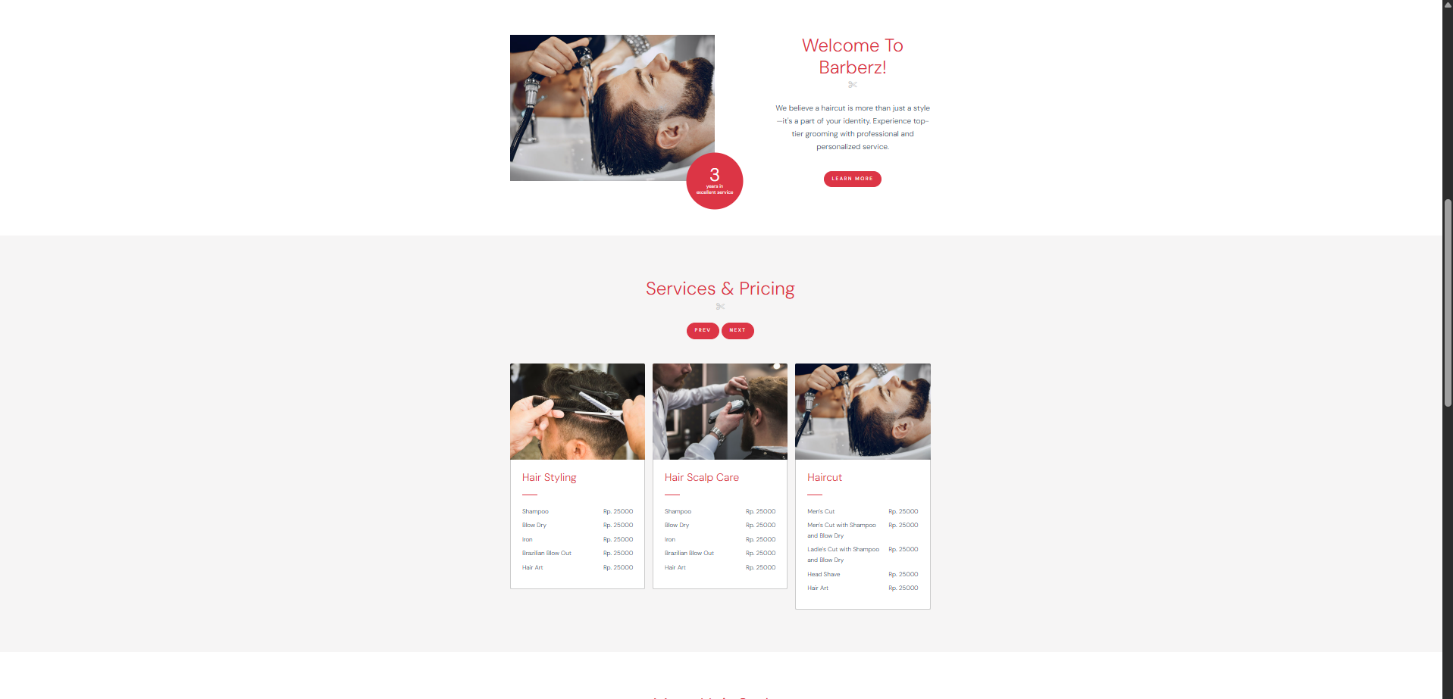
Halaman Utama

Slide 4

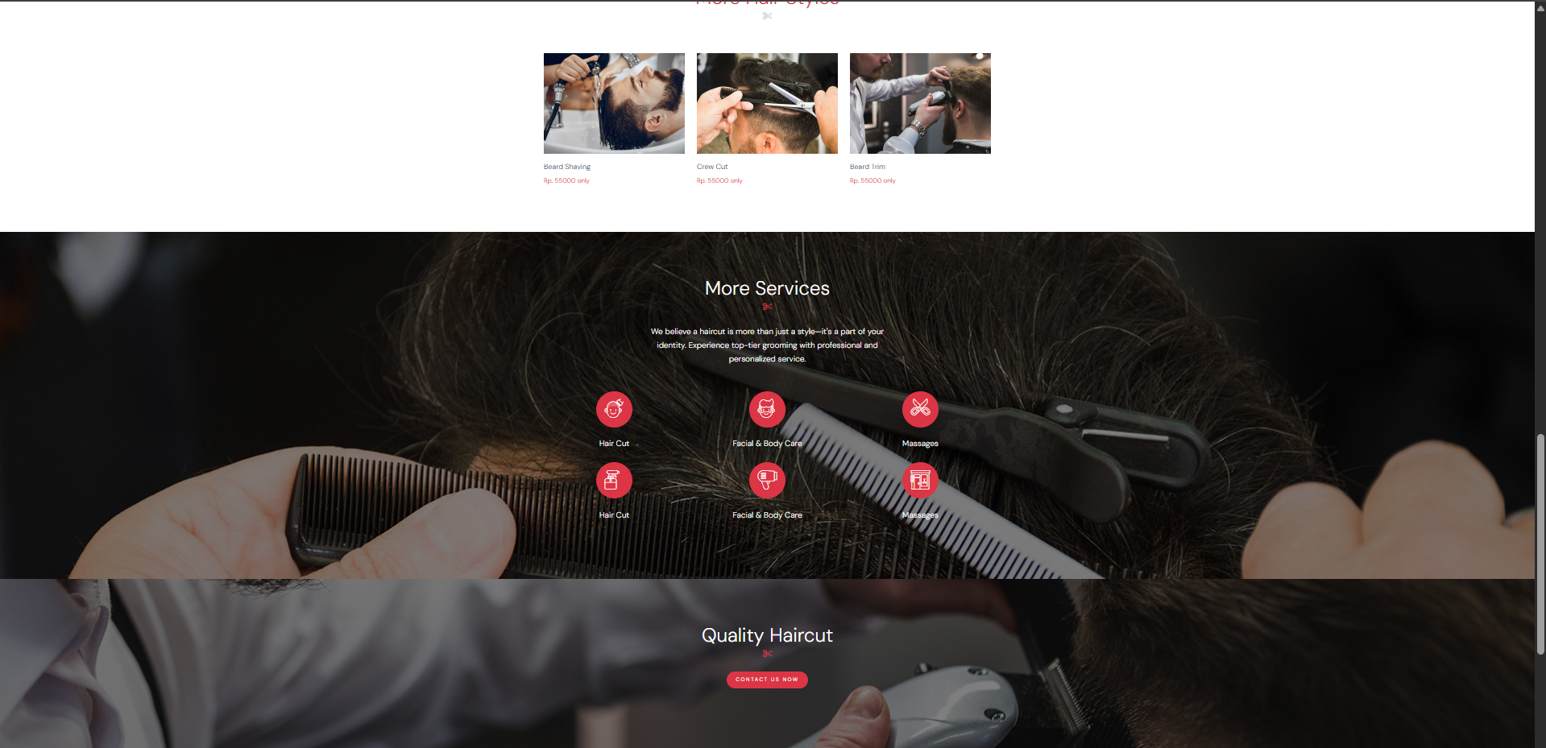
Halaman Utama

Slide 5
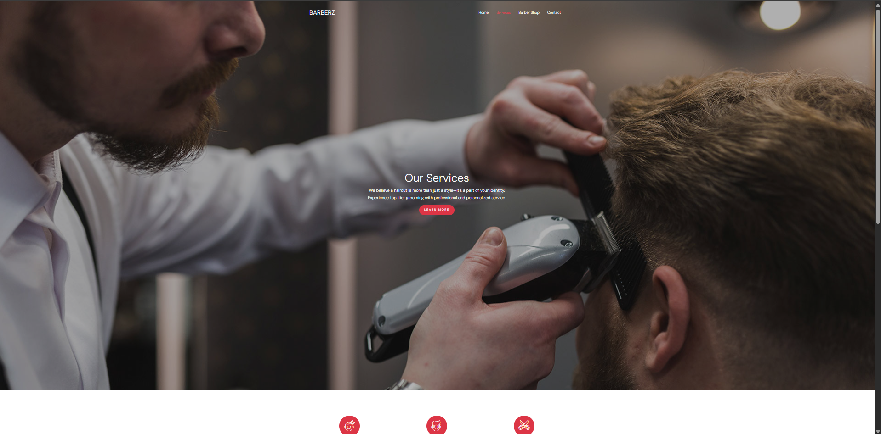
Halaman Service

Slide 6

Halaman Service

Slide 7
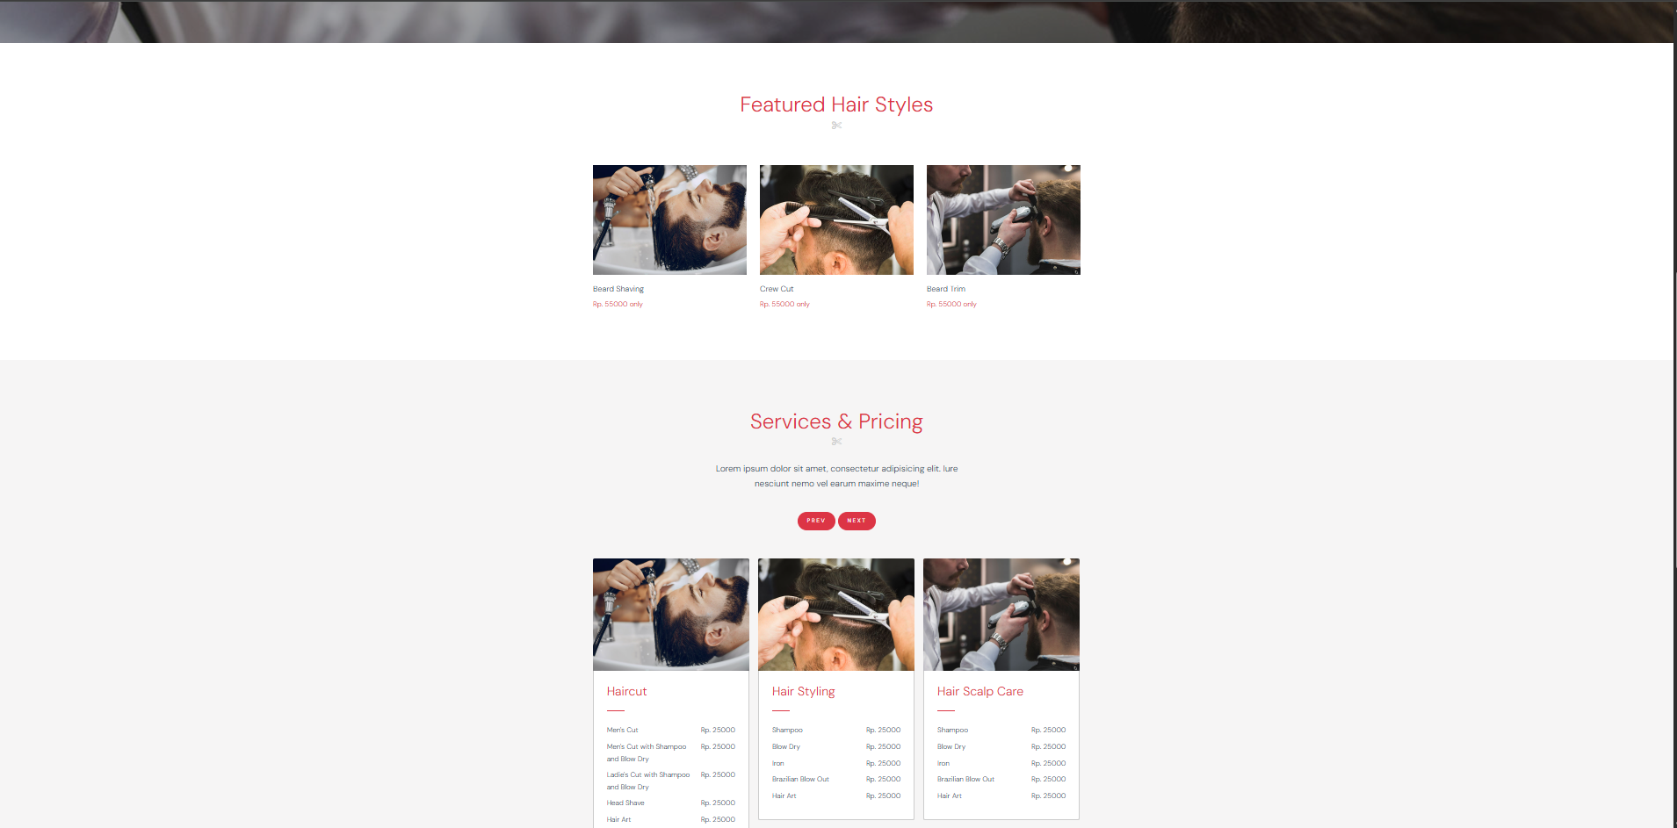
Halaman Barbershop

Slide 8
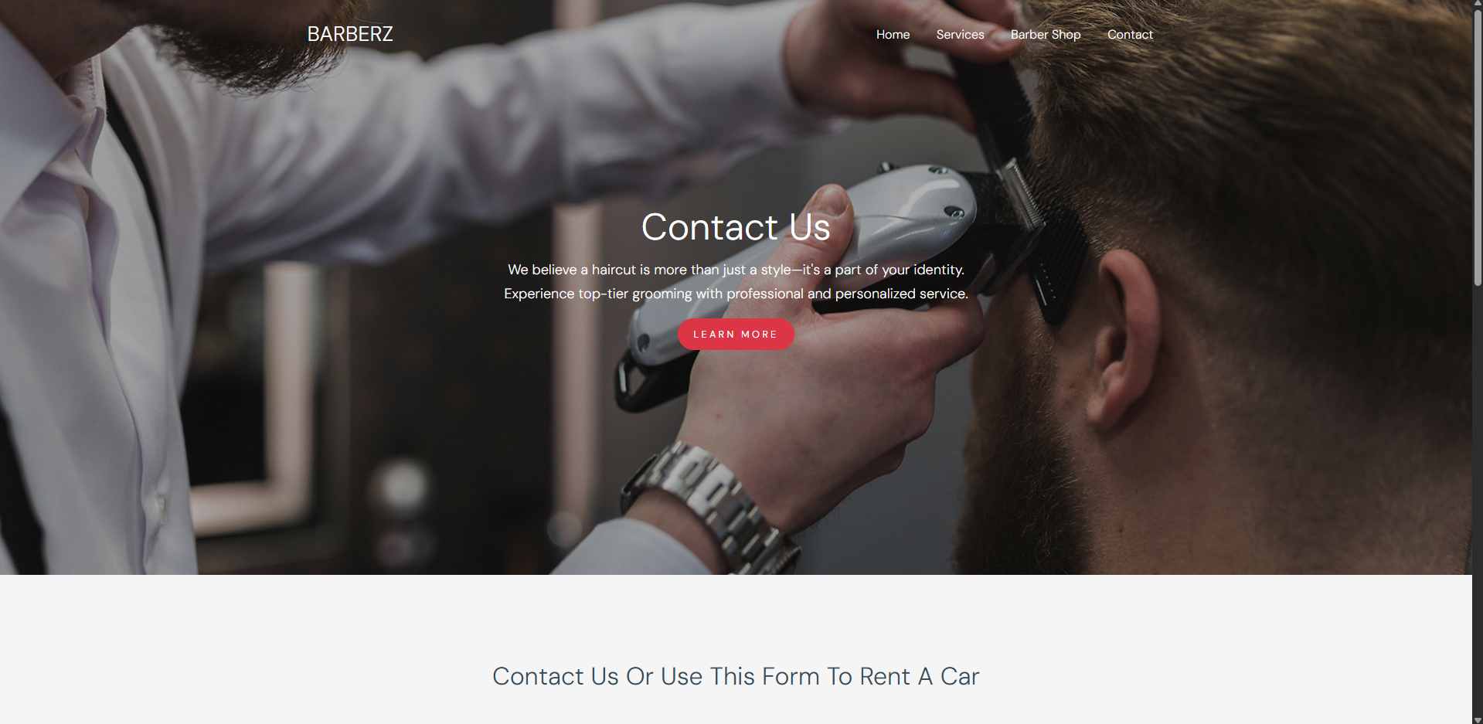
Halaman Contact us

Slide 9
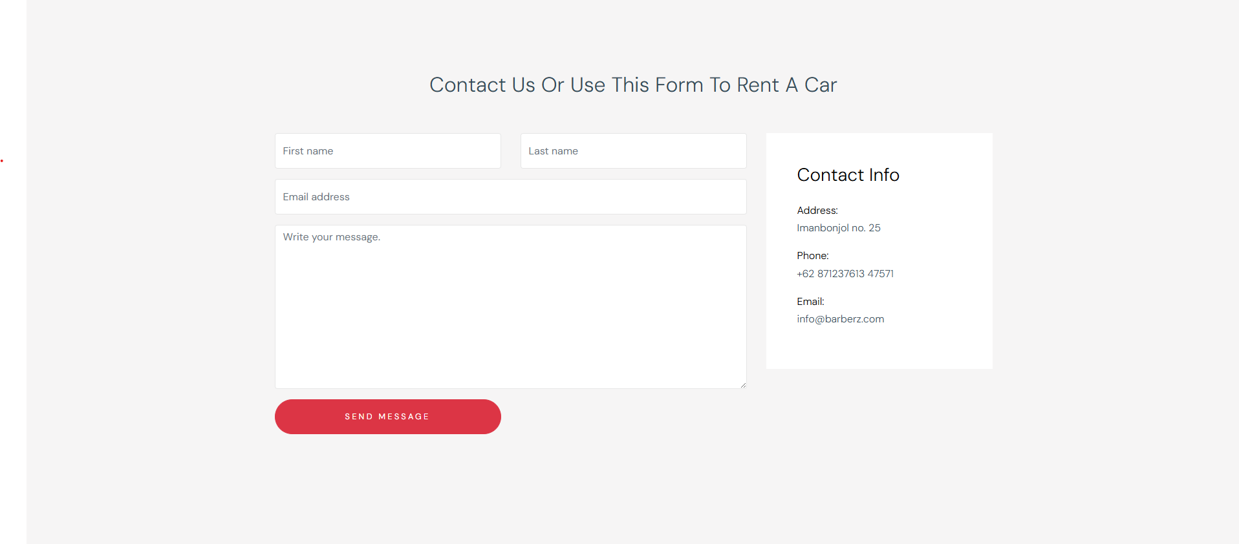
Halaman Contact us

Slide 10
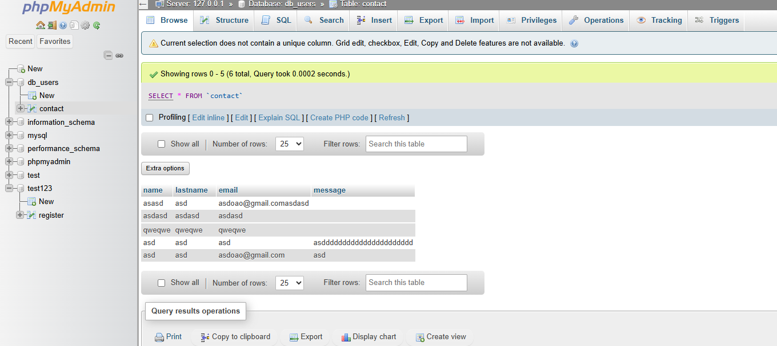
DATABASE PHPMYADMIN

